Slide 1
Quantifying risk in software using exploit and vulnerability data
Dr. Peter Brennan, B.Sc, H.Dip Comp.Sci, M.Sc, Ph.D

Slide 2
Aim of the work
Identify exploit and vulnerability data sources and management
Evaluate methodologies for quantifying levels of vulnerabilities and exploits data.
Identify sources of data (vfeed, exploitdb, netmarket trends, blackduck, wikipedia).
Identify software low in numbers of exploits and vulnerabilities.
Gain an understanding of what may be driving exploits and vulnerabilities in software (market share, Open source or closed source model, age (time since release) ).

Slide 3
Data sources
Vfeed is a python script that builds a upto date feed of vulnerability data from NIST building your own copy of NVD.
Script allows you to build or update database (SQLITE) periodically.
The database was enhanced by adding other data (Exploit.db) on exploit information held by offensive security.
Enhanced reporting layer (proprietary enhanced vfeed) built on vfeed (joins vulnerability and exploit data and denormalizes for reporting ease) which makes it easier to report on data. SQLite script used to do this.
Market share data scraped using rvest from netmarketshare, w3techs, DB-engines, Distro watch.
End of life info scraped from alohahsap.org,wikipedia using rvest.
Datasets assemebled in r using dplyr and sqldf to talk to enhanced vfeed.
Self collated mapping CPE to product file (csv) .

Slide 4
Vfeed- CPE’s and CVE’s
The Common Product Enumerator (CPE) is a logical, structured and systematic naming convention for information technology systems, software, and packages. CPE is made up of a explicit name format, a means for validating names against a system, and a description format for binding text and tests to a name.
The Common Vulnerabilities and Exposures (CVE) system is a means for referencing known information-security vulnerabilities and exposures.
They are sadly not used widely by vendors with some notable open source community products which have embraced the system (Apache, SQLite).
CPE’s need to be largely adopted as part of any software and hardware management solution, the only way to allow automated security auditing. Some organisations have done this largely in defence sector in US (have openly admitted their use and help maintain them).
However there is large scale adoption of CVE’s by all vendors and methodology developed by NIST has largely been adopted, (https://cve.mitre.org/cve/cna.html).

Slide 5
Measures used in the analysis
Exploit and vulnerability reporting is enhanced by one-hot encoding the type.
CVE scores are broken down by Base (effect) Scores, Temporal (effect) Scores, Environmental (effect) scores.
Scores run from range 0-10 (10 being worst) and are continuous in nature.
Complete documentation on scores is available here (https://www.first.org/cvss/v2/guide).

Slide 6
Visually analysing our data- heatmaps and distance matrices
Heatmaps are used because data is analysed within a particular technology branch (Desktop OS, Mobile OS, Web-browser, Web-server). High dimensionality, low number of observations data.
This type of data makes them ideal for use with heatmaps.
Heatmaps are used to quickly good or bad performing software in terms of reported exploits and vulnerabilities.
Heatmaps of distance matrix based (based on euclidean) on exploit and vulnerability matrix allows us to identify a particular product is from a particular “good” or “bad” solution.

Slide 7
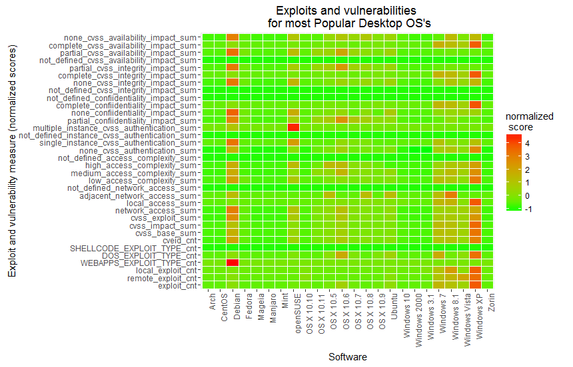
Visualizing exploits in Desktop OS’s (Green low, Red High, Grey no reported values)

Slide 8
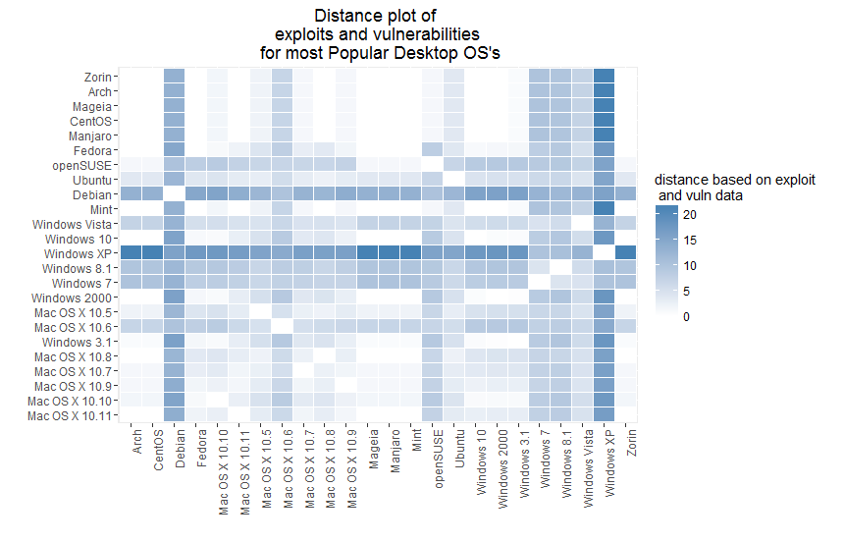
Heatmap of our distance matrix (Desktop OS’s) –how far am I from best case worst case.

Slide 9
What do they tell us for Desktop OS’s?
Desktop linux OS’s the safest, server centric linux OS’s look a bit worse and older versions of Windows and Mac Os-x look particularly unsafe (these also have the added problem of being out of support).
Heatmap allows us to calculate how far we are from a particular solution in terms of exploits and vulnerabilities, in this way you can quantify how bad or good a piece (in terms of exploits and vulnerabilities).
Can be easily extended for builds using multiple software products across different tech branches to quantify risk in terms of exploits and vulnerabilities.

Slide 10
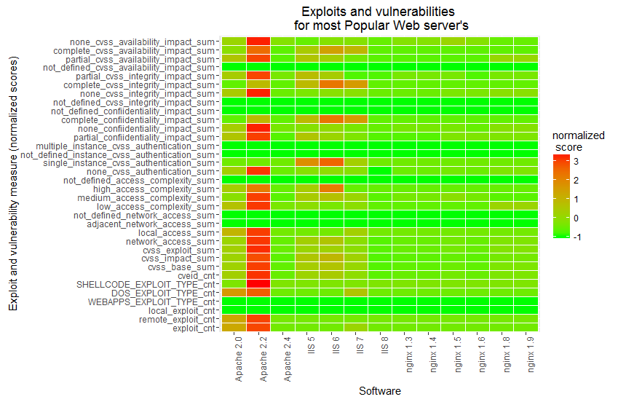
Web-server

Slide 11
Web-servers
Apache 2.2 pretty bad.
IIS except latest version pretty bad.
Nginx pretty good.
Apache 2.4 looks to perform best (low expression of vulnerabilities or exploits).

Slide 12
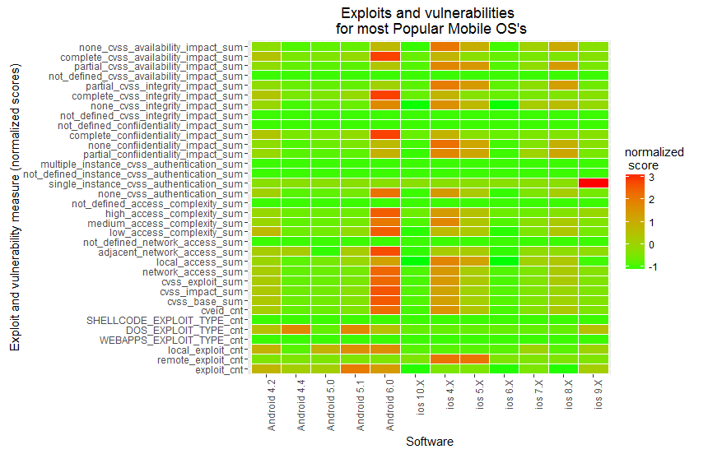
Mobile tablet

Slide 13
Mobile OS’s
Android looks to have a very high expression of exploits and vulnerabilities, especially Android 6.0, version with the highest market share.

Slide 14
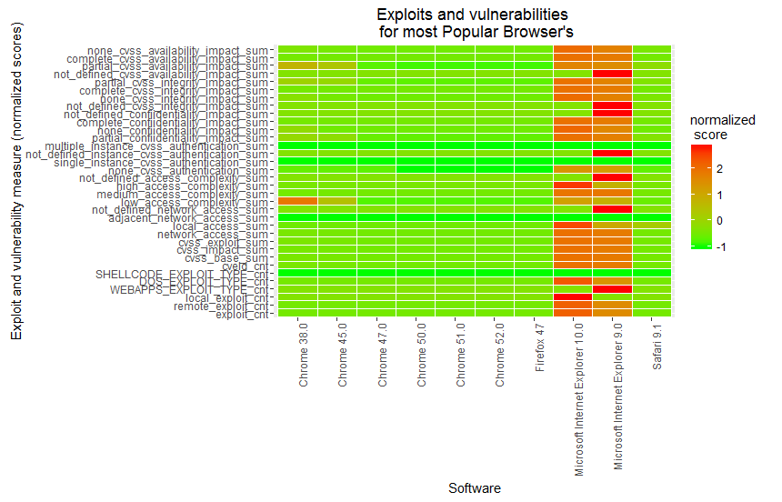
Browser

Slide 15
Browser
Open source software, even the popular one’s have low expression of vulnerabilities and exploits.
Closed source browsers IE 10 and 9 have high expression of vulnerabilities and exploits.

Slide 16
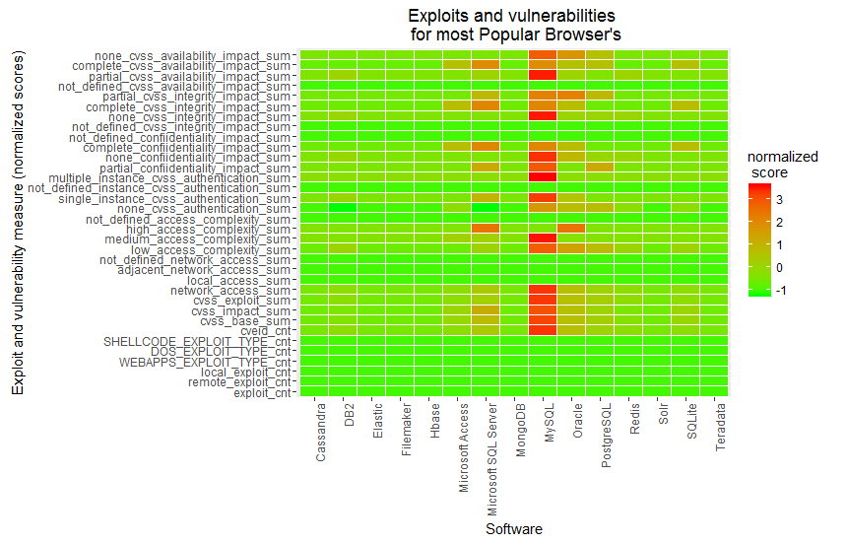
Databases

Slide 17
Databases
Databases (both open and closed source ) show large expression of vulnerabilities of exploits.
Open source databases even with low market share have low expression of exploits and vulnerabilities.

Slide 18
What else can we do with this data?
We can see that for some of technology branch’s there appeared to be a relationship between market share and expression of vulnerabilities and exploits and a piece of software.
There also appeared to be for some of the tech branch’s (databases) looked at a relationship between whether a software type being open source as opposed to closed source had on the expression of vulnerabilities and exploits.
Also we could see across all branch’s that some of the older software had a high expression of exploits and vulnerabilities.

Slide 19
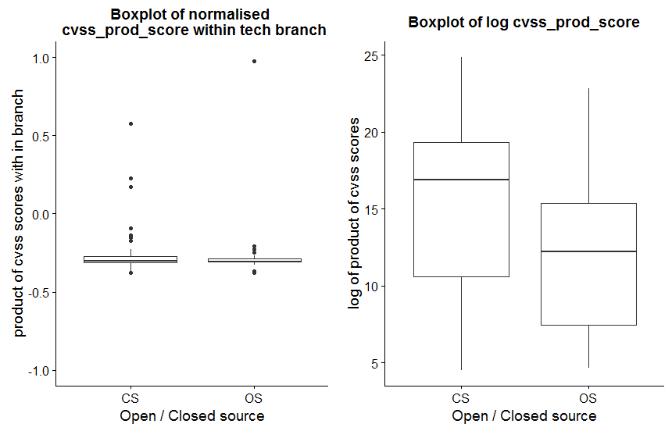
Difference in product of CVSS scores for open source and closed source

Slide 20
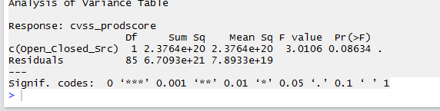
Difference in product of CVSS scores for open source and closed source
There appears to be a difference between the two from the boxplot. Lets run an ANOVA test. Its marginal

Slide 21

What about the relationship between market share and time since release with the product of CVSS scores?
There is positive correlation between CVSS prod scored (scaled within each of the different branch’s) and market share (within each branch) and the time since a product was released.

Slide 22
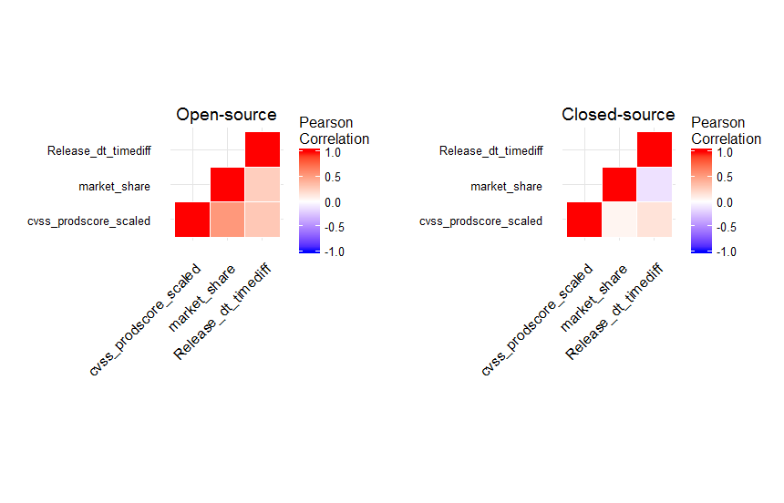
Is there a difference in the correlation between market share, release date timediff for open and closed source?

Slide 23
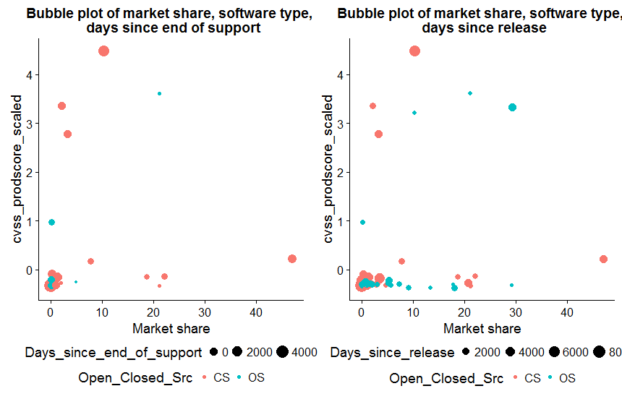
How do market share, days since release, days sine end of support effect level of vulnerability in software?

Slide 24
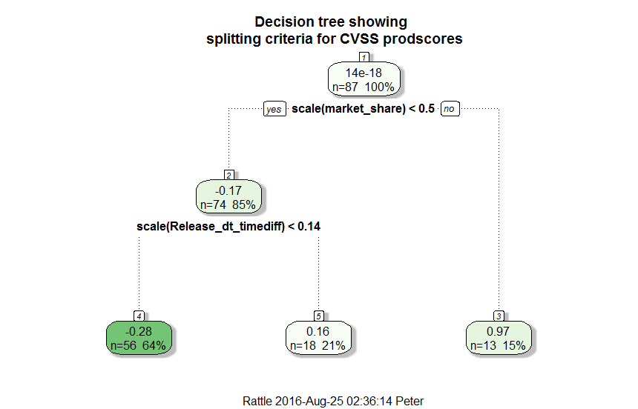
Can we model Product of CVSS scores in terms of market share , time since release and whether its open or closed source.

Slide 25
Tree explained
R² =0.7932, Press statistic = -0.0843364
Interpretation the further up the tree the more important the criteria. Market share most important, whether open source or closed source not important.
Software with high market share have high CVSS prodscore (scaled within branch).
Lower market share, software CVSS prodscores dependent on how old it is?
Open and closed source does not affect the CVSS prodscore.

Slide 26
Conclusions
Heatmaps are an effective means of visualizing exploits in software.
Distance matrices can be used to see how far a software product is from best in class or worst in class. These can also be visualized with distance matrices.
Using CVSS prodscores (product of (impact, exploit and the base score) appears to be strong relationship between market share and CVSS prodscores, this is especially true in the case of Open source software.

Slide 27
What next?
Additional data should be integrated into project to see how they affect analysis of CVSS prod scores or exploit counts, such as number of contributors to project or code base by language.
Text analysis of exploit and vulnerability data.
Versioning of exploit and vulnerability data, to see how they change over time, change point detection for vulnerabilities and exploits in software.

